Slide 1
Research & Development Project
Frequency Festival 2015
-
Michael Burton

Slide 2
Frequency Festival - Main Components
Knowledge Sharing:
The global connection.
The Enhanced Imagination:
Use of digital tools enhancing development.
The Liberation of the Digital Human:
The integration with the digital realm, extending our sense
and our real time social reach.

Slide 3
Liberation
The definition of liberation falls under the following definitions:
The act of liberating or the state of being liberated.
The gaining of equal rights or full social or economic opportunities for a particular group.
The gaining of protection from abuse or exploitation.
Current and recent issues surrounding the internet are forming the debates around the ‘rights of a cybercitizen’.

Slide 4
Project Idea
Project relates to free speech, how the internet and digital technology allow people to express their opinions, either through anonymity or through the digital realm.
The idea behind the project is to enhance digital media for the bringing about of change, to fuel liberation. Whilst offering a safe place to do so.
The project idea incorporates a key right of a cybercitizen, freedom of speech.

Slide 5
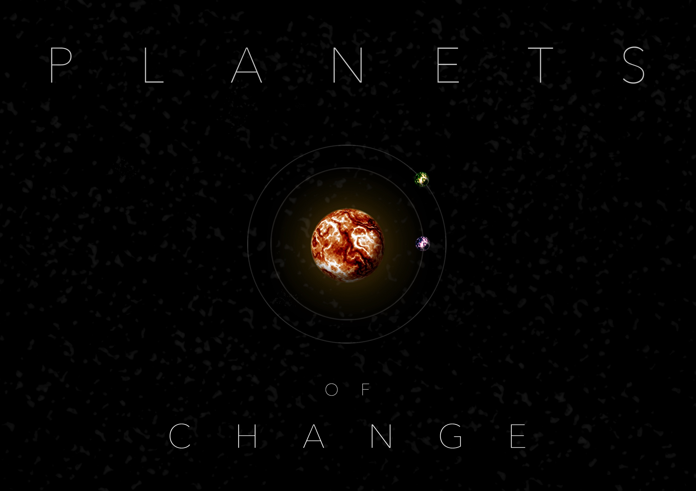
Planets of Change

Slide 6
Planets of Change
The projects aim is to get spectators to think. Explore the contributions and submit their own, based around issues that affect the world or themselves.
Users will draw a planet, name that planet and attach a message or statement to their contribution.
This statement can relate to something the contributor feels needs to be voiced, or discussed.
Once the planet is submitted it will (hopefully) join a solar system filled with other contributed planets attached to their own message.

Slide 8
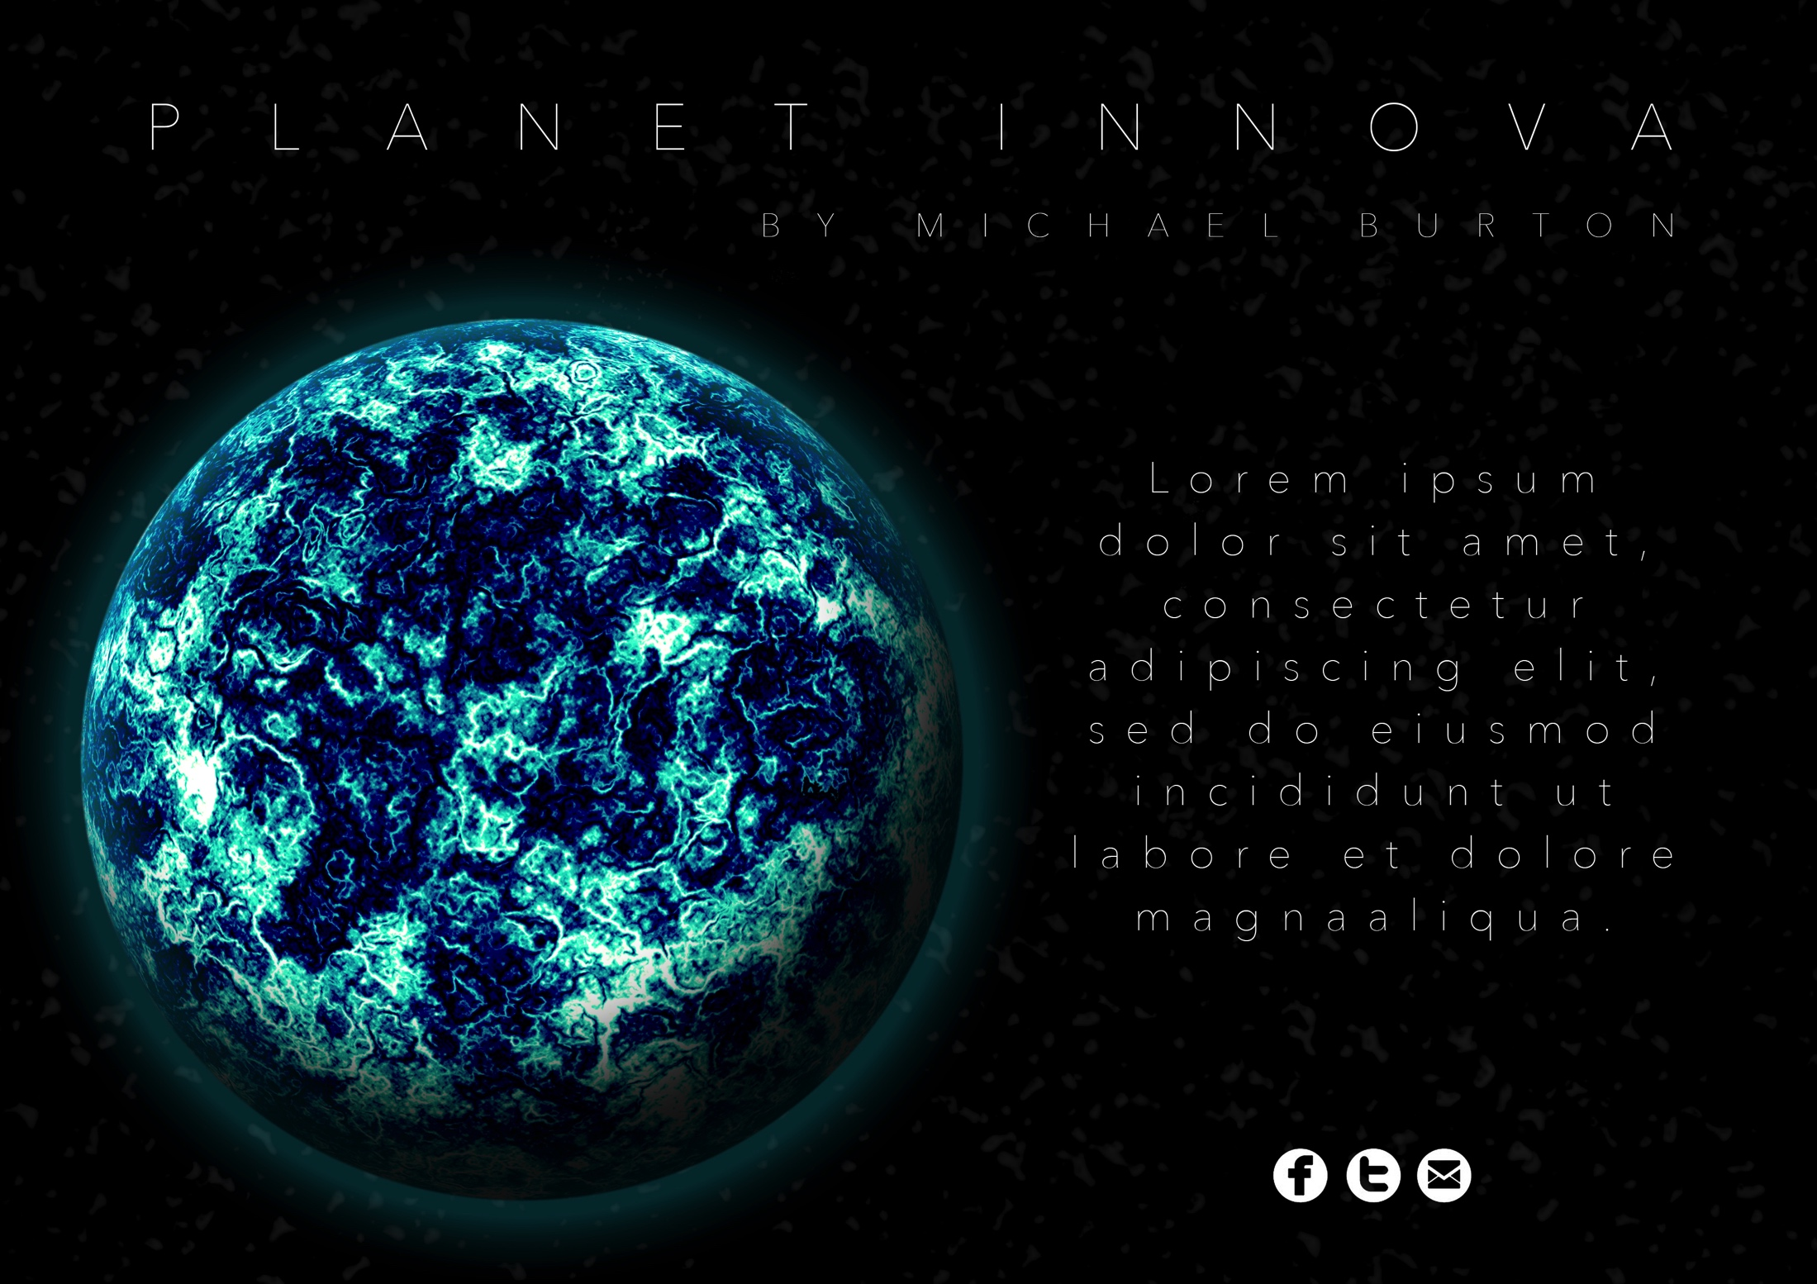

Slide 9
Location / Installation
Current idea is to use a portable tent or dome to house the installation of the project.
The dome can be situated in a populated stretch of the Festival to ensure maximum participation from an audience.
The dome will be dimly lit to enhance the viewing of the project.
Contributions to the project by an audience will also be able to be made on location, through the use of iPad stations inside the dome.

Slide 10
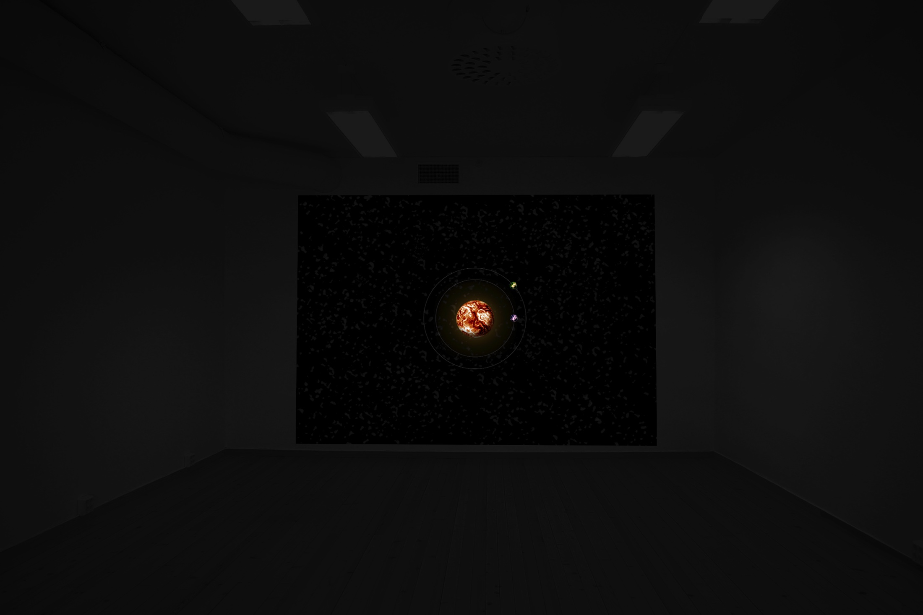
-

Slide 12
Project Research

Slide 13
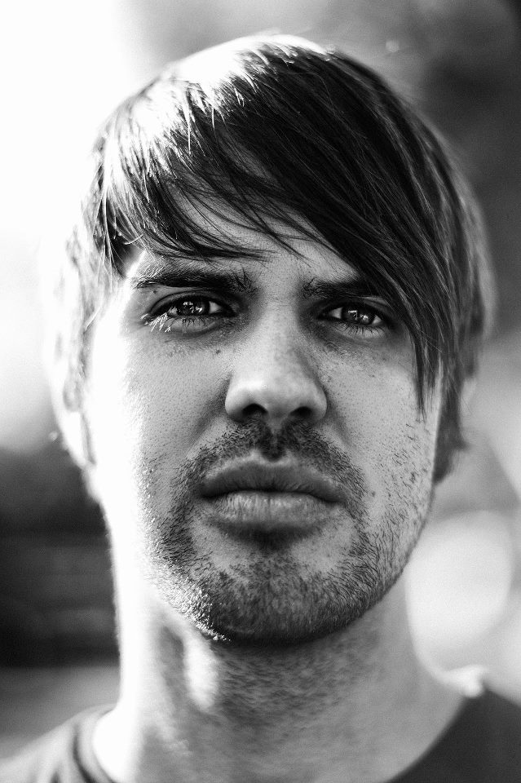
Aaron Koblin
Researched into projects centered closely around audience interaction, through anonymous contributions to collective projects.
His style of work relates strongly to the main components of the Frequency Theme of Liberation.
I felt that the key components of his
collective projects should be at the heart
of a project based around the rights of a
cybercitizen.

Slide 14
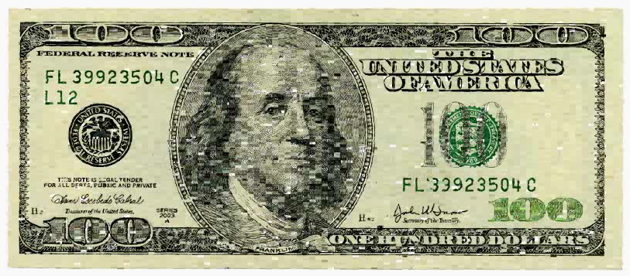
Ten Thousand Cents
- 10,000 individual artists anonymously worked on an individual sector of the $100 bill, with each artist being paid 1 cent. Over the duration of the project all sections of the $100 bill were drawn in a number of different ways, eventually leading to the completion of the project.

Slide 15
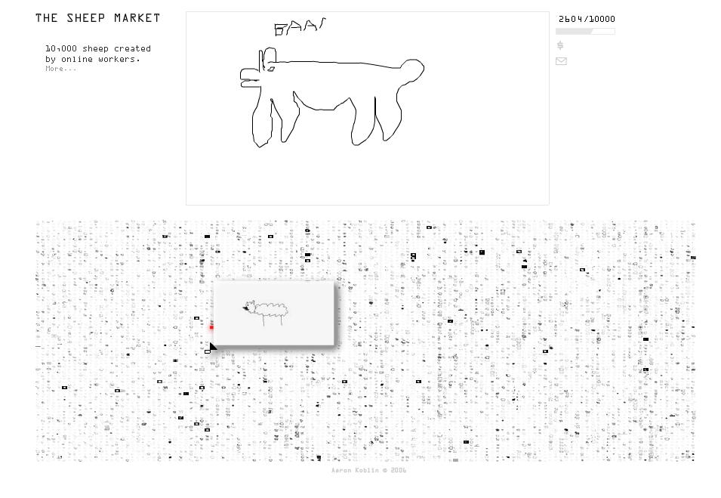
The Sheep Market
- Focused on the creation of 10,000 individual sheep by workers on Amazon’s Mechanical Turk. Each worker was paid 2 cents to draw a sheep facing to the left. This project again focused around the anonymity of its contributors. The required 10,000 sheep were collected in 40 days, with the project being accessed through 7599 unique IP addresses.

Slide 16
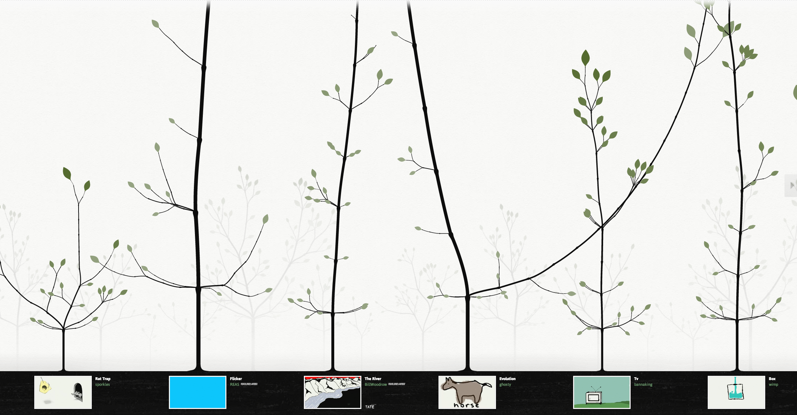
This Exquisite Forest
- The project is one that I find extremely fascinating. It follows the same process of previous projects that focus on the anonymous contribution of hundreds of people, for the creation and competition of the project. However this project does not simply collect the contributions of its users, it collects them for others to develop them further. The project is a collective animation at heart, with each user contributing the next frame of the animation. The end result in extremely interesting to watch, as your constantly wondering what the animation will flow into next.

Slide 17
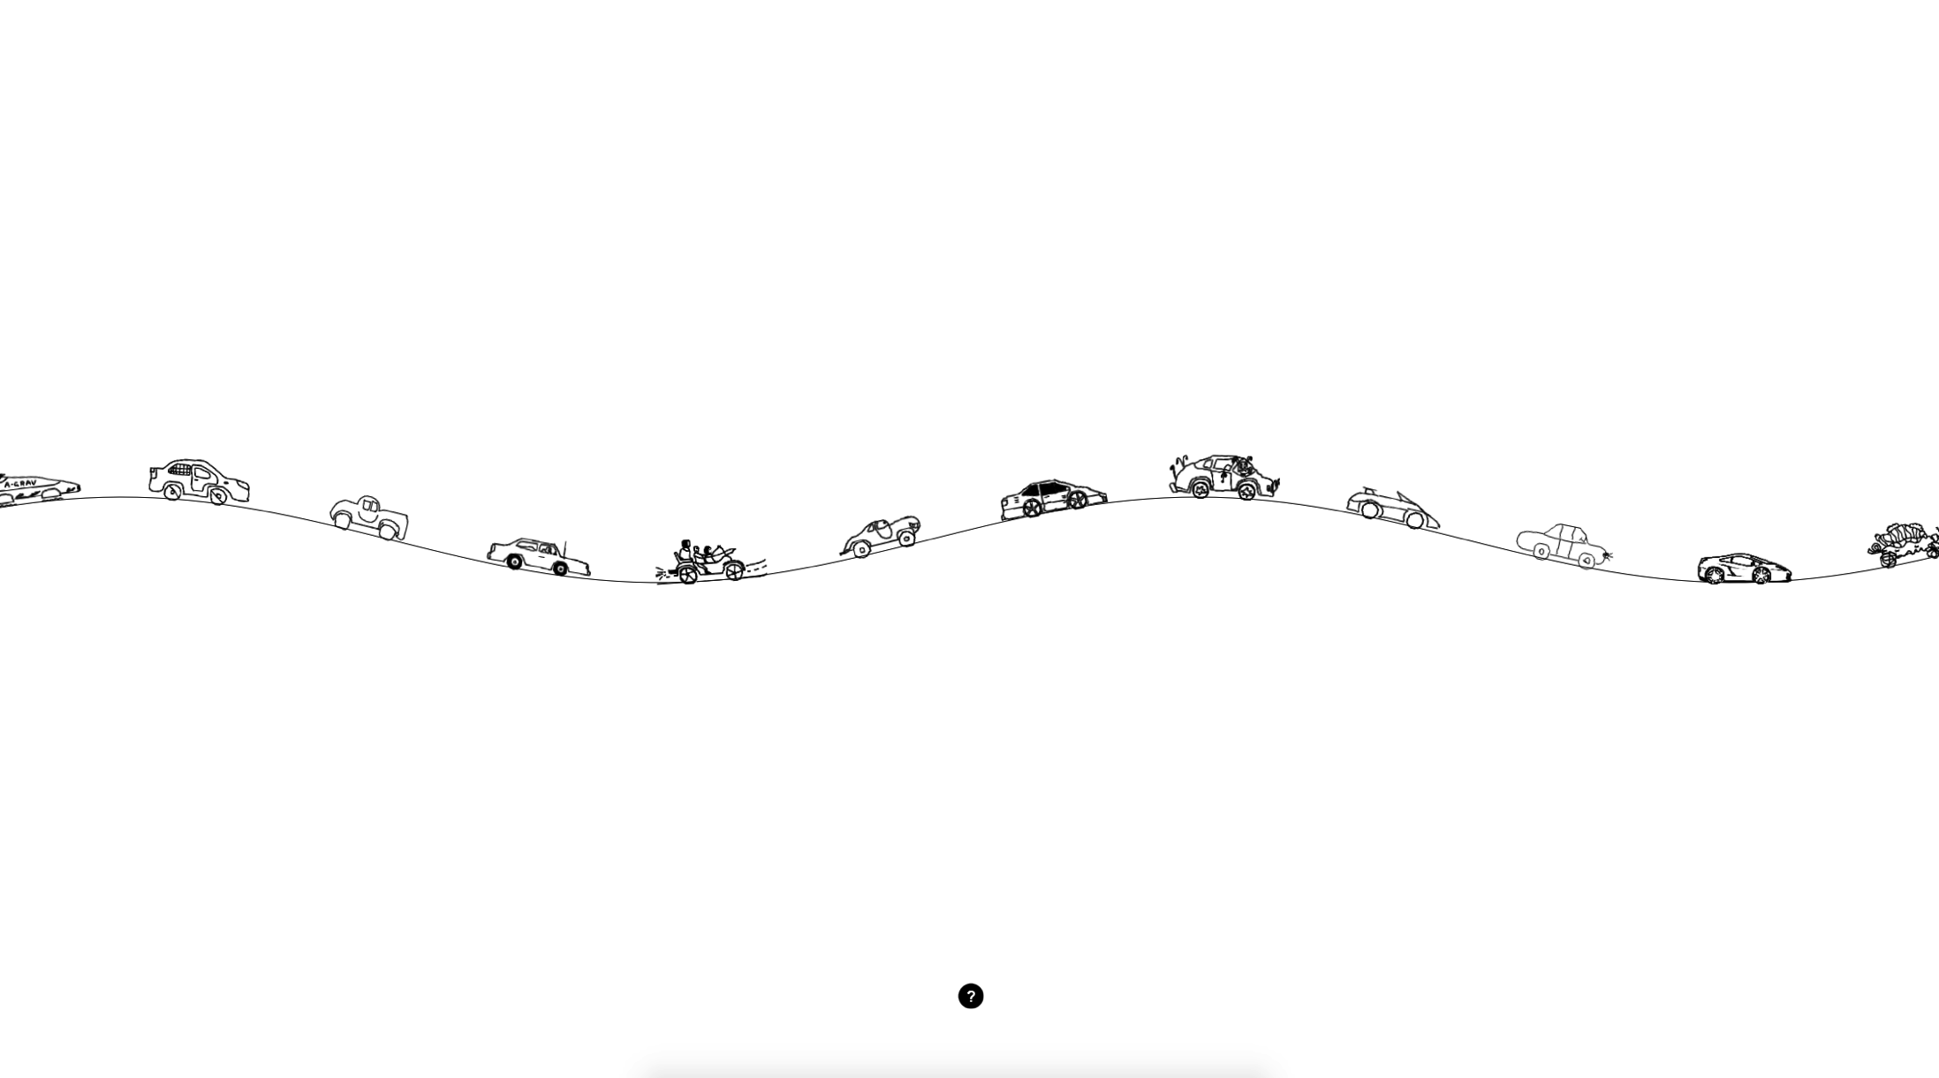
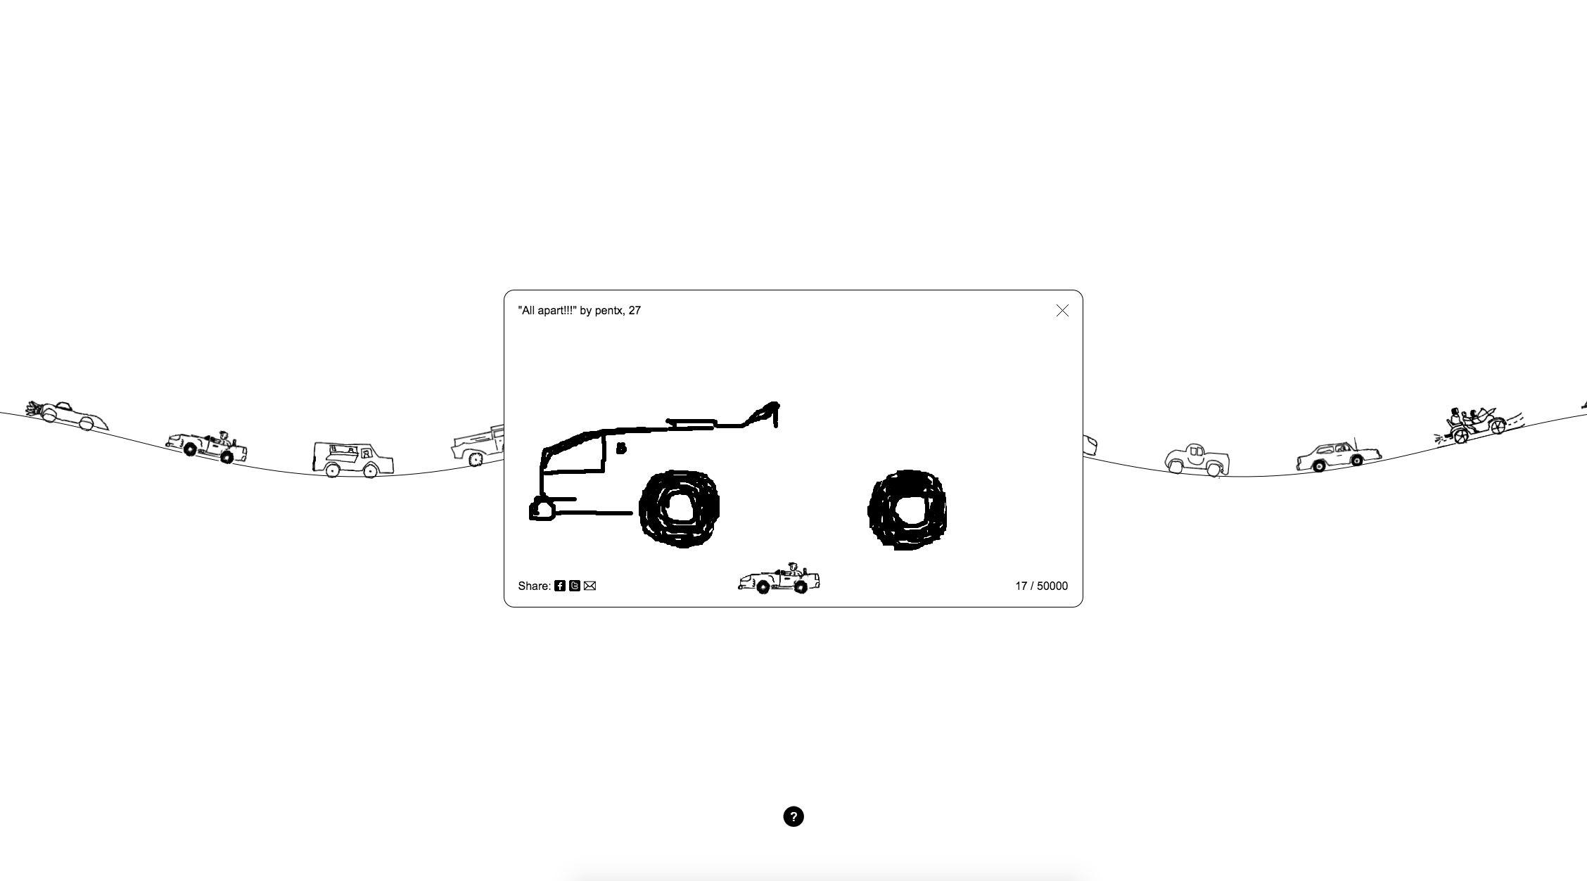
The Single Lane Super Highway
Based simply around contributors drawing a car in their desired style, which is then added to the project, joining an endless highway. Each car slowly drives across the screen one after the other. The cars themselves are animated after submission with the wheels turning as the cars drive across the screen.

Slide 18
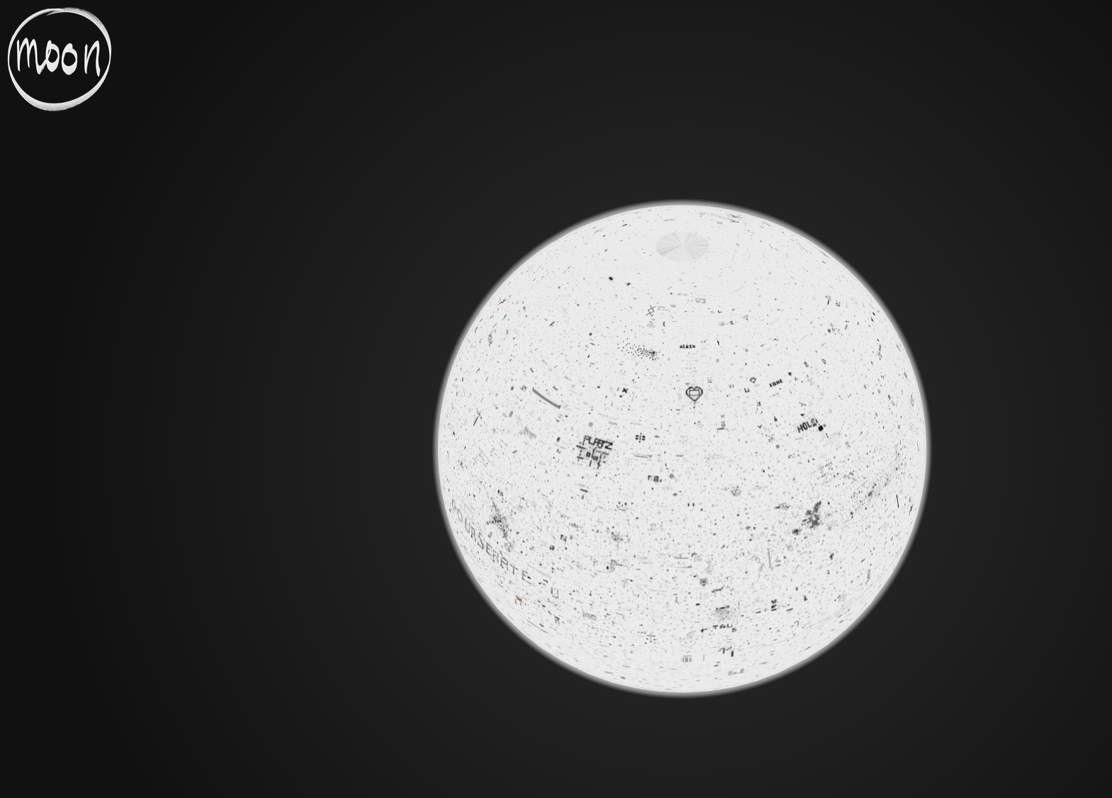

Slide 19
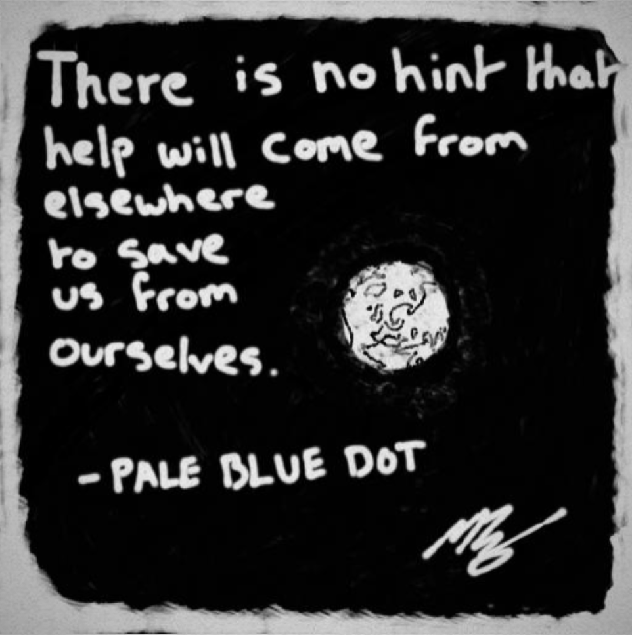
Ai Weiwei - moon
Project is based around a digital platform, enabling the digital community to voice their message.
Visuals are simple, along with the idea of the project.
Felt this project fitted perfectly into the theme of Liberation in terms of ‘the rights of a cybercitizen’.

Slide 21
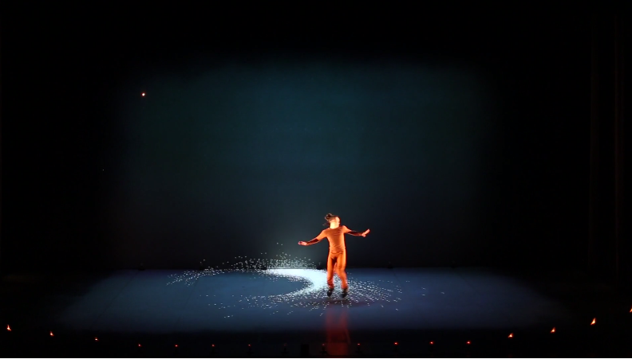
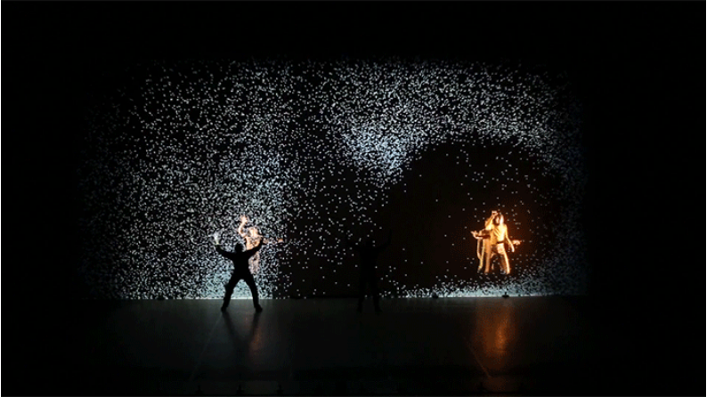
PIXEL
PIXEL is a dance performance project that incorporates the use of digital projections in coloration with movement.
Felt aspects of this could be included within my project idea.
To add another dimension to the project.

Slide 22
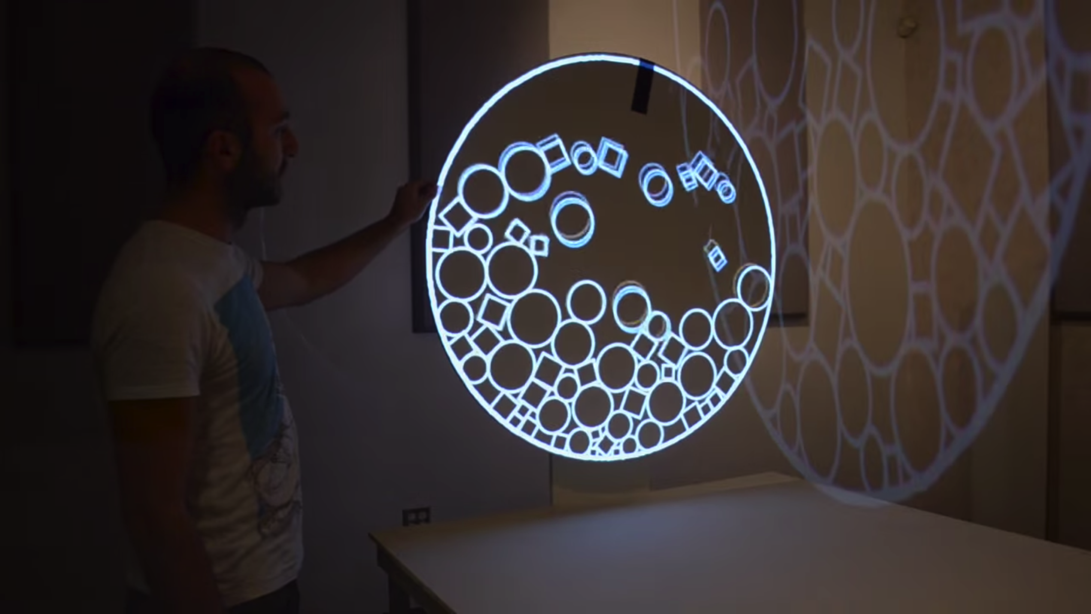
Rotary Tumble
A simple interactive piece that makes use of motion tracking for interaction.
Displayed through a projection, that can be manipulated by the viewer.
The use of motion tracking could be included within my project idea for the manipulation of the planets (navigation, rotation, selection etc.).

Slide 23
Thank You

